Slide 1
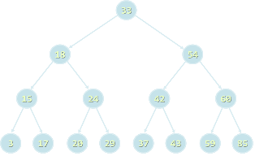
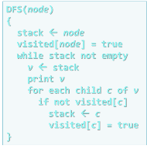
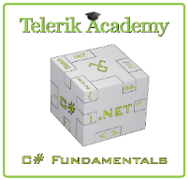

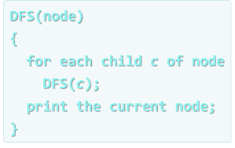
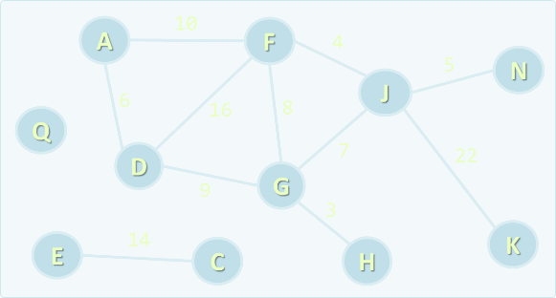
Data Structures and Algorithms
Course Program, Evaluation, Exams, Resources
Svetlin Nakov
Technical Trainer
www.nakov.com
Telerik Software Academy
academy.telerik.com

Slide 2

Table of Contents
What's Coming Next in the Academy?
The Data Structures and Algorithms Program
The Trainers Team
Exams and Evaluation
The Practical Exam
Recommended Books
Resources for the Course
Champions from High-Quality Code and JavaScript Part II

Slide 3

Data Structures & Algorithms
The Next Module in the Software Academy (The Programming Track)

Slide 4

What's Coming Next?
Data Structures and Algorithms (DS&A)
Continuation of High-Quality Code course
Data structures (lists, trees, hash-tables, graphs), complexity, algorithms (recursion, combinatorics, dynamic programming, graphs)
Pretty much the same
Lectures 2 times a week
The course exam?
Practical exam (@ BGCoder)

Slide 5
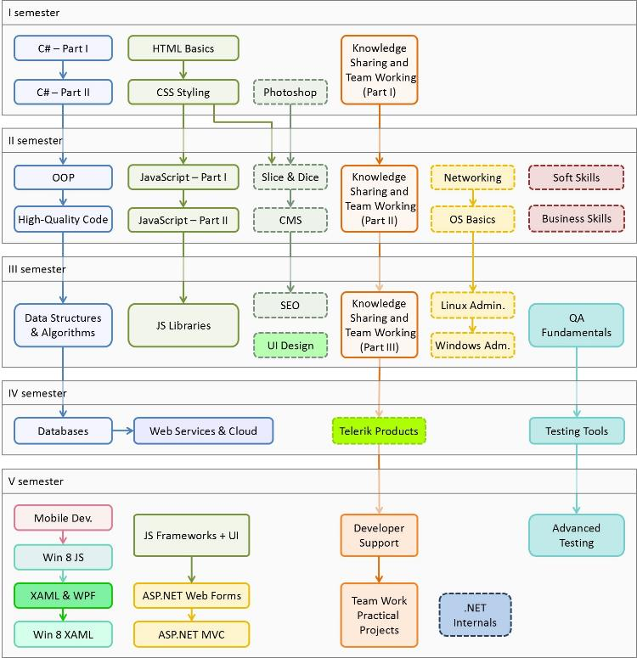

C# Programming Track
Software Academy Curriculum
Specialties @ the Academy
Success Stories @ Telerik

Slide 6


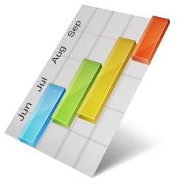
Data Structures and Algorithms Course Program
What Will We Cover in the Course?

Slide 7
The Course Program
Course Overview. Overview of Data Structures, ADT and Algorithms. Algorithm Complexity. Linear Data Structures: List, Queue, Stack
Trees, Tree-Like Structures, Balanced Search Trees. Tree Traversals: BFS and DFS
Dictionaries, Hash Tables and Sets
Advanced Data Structures. Wintellect Power Collections. Bag, Multi-Dictionary, Priority Queue. Data Structure Efficiency. Sorting and Searching Algorithms

Slide 8

The Course Program (2)
Recursion and Combinatorial Algorithms. Generating Variations, Permutations, Combinations
Dynamic Programming. Divide-and-Conquer. Classical Dynamic Programming Problems
Graphs, Representation and Basic Graph Algorithms (Shortest Paths, Minimal Spanning Tree). Other Algorithms (Greedy, Geometry, Randomized)
Problem Solving Methodology. Exam Preparation

Slide 9
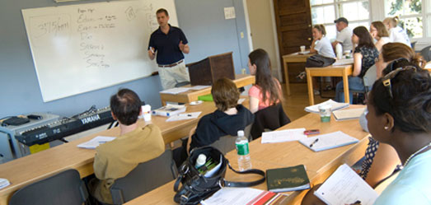
The Trainers Team

Slide 10
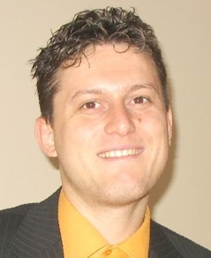
Trainers Team
Svetlin Nakov, PhD
Manager Technical Training @ Telerik Software Academy
20 years software development experience
10+ years experience as trainer
Author of 6 books
Speaker at hundreds of events
E-mail: svetlin.nakov [at] telerik.com
Web site / Blog: http://nakov.com

Slide 11
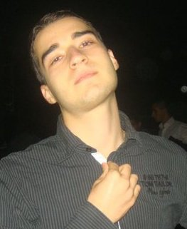
Trainers Team (2)
Nikolay Kostov
Senior Software Developer and Technical Trainer @ Telerik Corp.
Student in Sofia University
Computer Science
IT and Informatics competitions contestant
Graduate from the second season of Telerik Software Academy
Email: nikolay.kostov [at] telerik.com
Blog: http://nikolay.it

Slide 12

Volunteer Trainers
Students from the academy
Ivaylo Kenov
Penka Borukova
Evlogi Hristov
Maybe few others

Slide 13



Evaluation
Data
Strucs
Thank God There Are Bonuses!
Algo-
rithms
Exams!

Slide 14

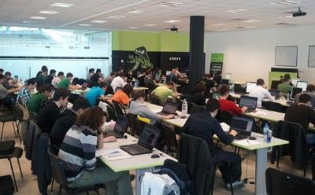
Data Structures & Algorithms – Evaluation
Evaluation components
Practical exam – 70%
Homework – 10%
Homework evaluation – 10%
Attendance in class – 10%
Bonuses
Forums activity – bonus up to 10%
Helping the other students – bonus up to 10%
PC Magazine contest – bonus up to 10%

Slide 15


Pass / Excellence / Fail Criteria
Criteria for pass / pass with excellence / fail
Pass with excellence
Very high exam results
or
High total results
Pass
Average total results
Fail
Low total results or low exam results

Slide 16
Homework Peer Reviews
Everyone will get feedback for their homework
Everyone will give feedback for few random homework submissions
Students submit homework anonymously
Please exclude your name from the submissions!
For each homework submitted
Students evaluate 3 random homeworks
From the same topic, after the deadline
Give written feedback, at least 200 characters
Low-quality feedback → report for punishment

Slide 17

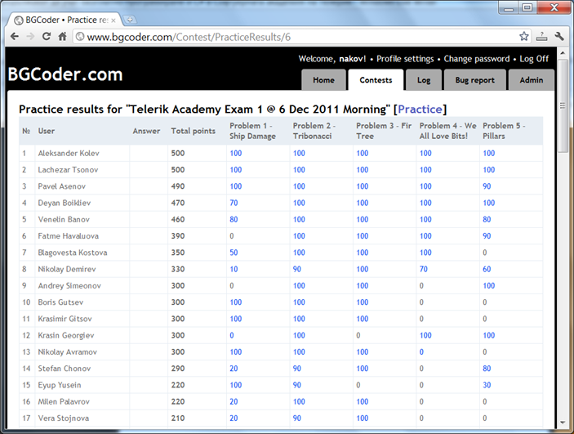
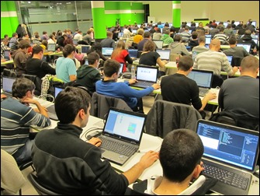
Practical Exam
5 practical problems for 8 hours
Real-time feedback @ BGCoder

Slide 18



Use the Same Email!
Please use the same email address in:
http://telerikacademy.com
http://bgcoder.com
http://forums.academy.telerik.com
Otherwise your score could be incorrectly calculated!

Slide 19

Recommended Books

Slide 20

The C# Textbook
The official textbook for the course
“Introduction to Programming with C#”, Nakov S. and his team, 2010
Freely downloadable from: www.introprogramming.info
The C# programming tracks follows the book
Data Structures → chapters 16-19
Algorithms → chapters 23-26 (partially)

Slide 21
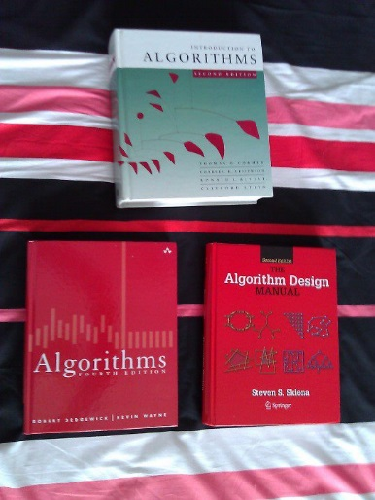

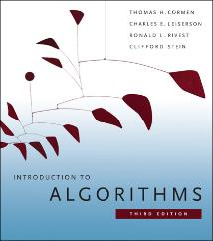
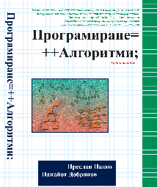
Recommended Books
Telerik Algo Academy
algoacademy.telerik.com
Introduction to Algorithms Cormen, Leiserson, Rivest, and Stein ISBN 9780262033848, goo.gl/cf3b5
Programming = ++Algorithms; Preslav Nakov, Panayot Dobrikov, ISBN 954-8905-06-X www.programirane.org

Slide 22








Resources
What We Need in Addition to this Course Content?

Slide 23
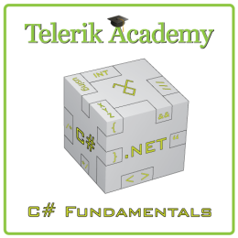
Course Web Site & Forums
Register for the "Telerik Academy Forums":
Discuss the course exercises with your colleagues
Find solutions for the exercises
Share source code / discuss ideas
The DS&A official web site:
forums.academy.telerik.com/csharp-fundamentals
http://academy.telerik.com/student-courses/programming/data-structures-algorithms/

Slide 24
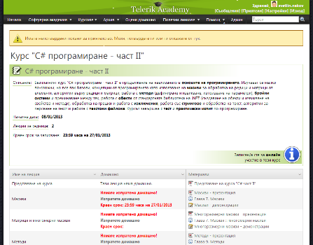
Telerik Integrated Learning System (TILS)
The Telerik Integrated Learning System (TILS)
www.telerikacademy.com
Important resource for all students
Homework submissions
Homework peer reviews
Presence cards with barcode
Reports about your results
telerikacademy.com/Courses/Courses/Details/89

Slide 25


Required Software
Software needed for this course:
Microsoft Windows (XP / Win7 / Win8)
Microsoft Visual Studio 2012 or Visual Studio Express 2012 (free version of VS 2012)
.NET Framework 4.5 (included in Visual Studio)
Visual Studio 2005, 2008 or 2010 is also OK

Slide 26


Champions from the Exams
Telerik Academy Ninja Champions

Slide 27

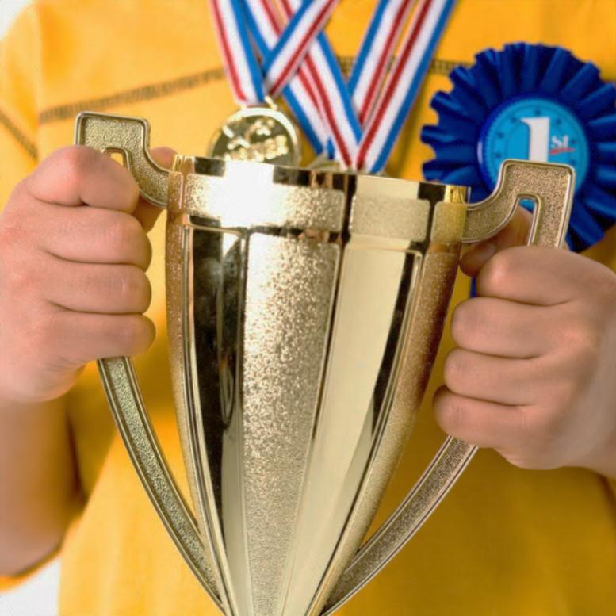
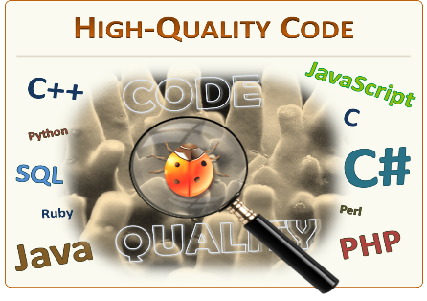
Champions: High-Quality Code
#1 – Alexander Trifonov
#2 – Vladislav Karamfilov
#3 – Teodor Kurtev

Slide 28

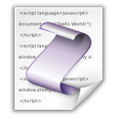
Champions: JavaScript Part II
#1 – Victor Alexiev
#2 – Teodor Kurtev
#3 – Ivaylo Kenov

Slide 29



Most Helping Students
Quality Code: Victor Alexiev
JavaScript II: Victor Alexiev

Slide 30
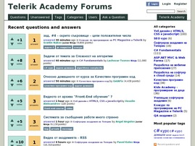
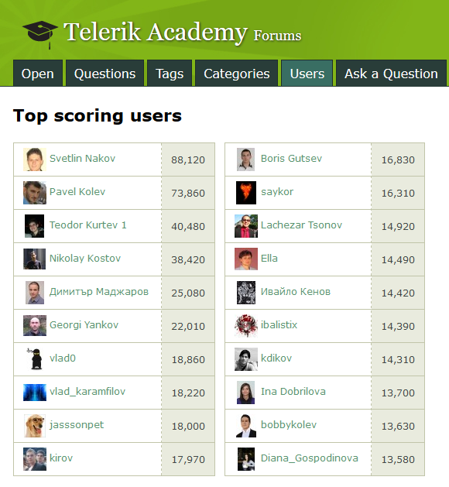
Most Active Students in the Forum
# 1 – Teodor Kurtev

Slide 31



PC Magazine Champions
NASA Space Apps Challenge and PC Magazine Programming Contest – Round #3 & #4
#1 – Antony Jekov
#2 – Ralitsa Nikiforova
#3 – Kaloyan Borislavov
* More info at www.facebook.com/SpaceAppsChallenge2013Sofia, konkurs.pcmagbg.net

Slide 32


The Absolute Champion
The absolute champion of the High-Quality Code and JavaScript Part 2 :
# 1 – Alexander Trifonov

Slide 33
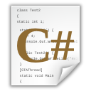
Data Structures and Algorithms
http://academy.telerik.com

Slide 34
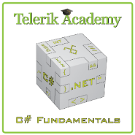



Free Trainings @ Telerik Academy
C# Programming @ Telerik Academy
csharpfundamentals.telerik.com
Telerik Software Academy
academy.telerik.com
Telerik Academy @ Facebook
facebook.com/TelerikAcademy
Telerik Software Academy Forums
forums.academy.telerik.com

